Slide 1
Dependent Student and Direct Unsubsidized Loan

Slide 2
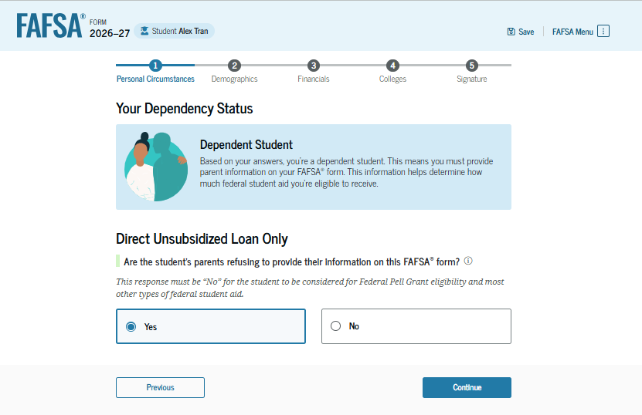
Dependency Status: Dependent Student
If the parents of a dependent student are unwilling to provide information on the FAFSA® form but the student doesn’t have an unusual circumstance, the student can choose to have their school determine eligibility for a Direct Unsubsidized Loan only.
Note: Selecting "Yes" here makes the student ineligible for other types of federal student aid, such as Federal Pell Grants, Federal Work-Study, or Direct Subsidized Loans.

Slide 3
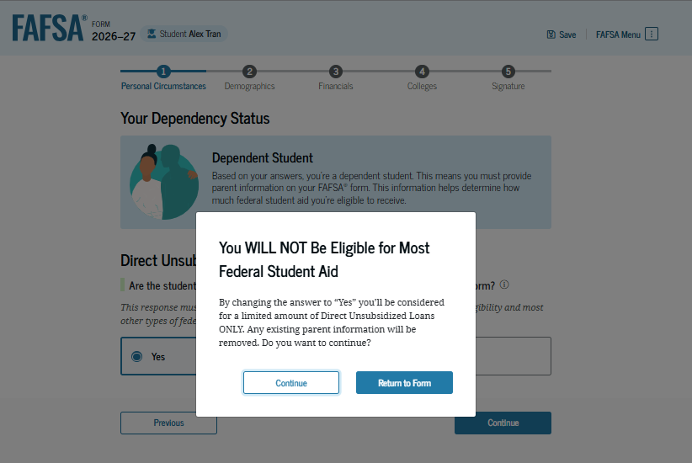
Dependent Student Selects Direct Unsubsidized Loan Only
If the student selects "Yes" to have their school determine eligibility for a Direct Unsubsidized Loan only and then selects "Continue," a pop-up window appears warning the student that they will not be eligible for most federal student aid.

Slide 4
Unaccompanied Homeless Youth

Slide 5
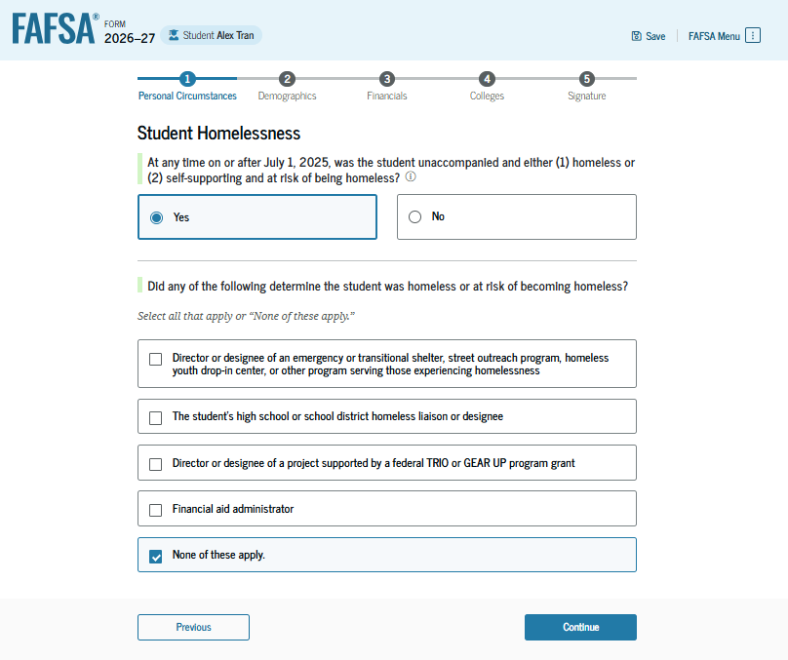
Student Homelessness
The student is asked if they were unaccompanied and either homeless or at risk of being homeless. If so, the student selects "Yes." Next, the student is asked who determined that they are homeless or at risk of being homeless. The student selects "None of these apply."

Slide 6
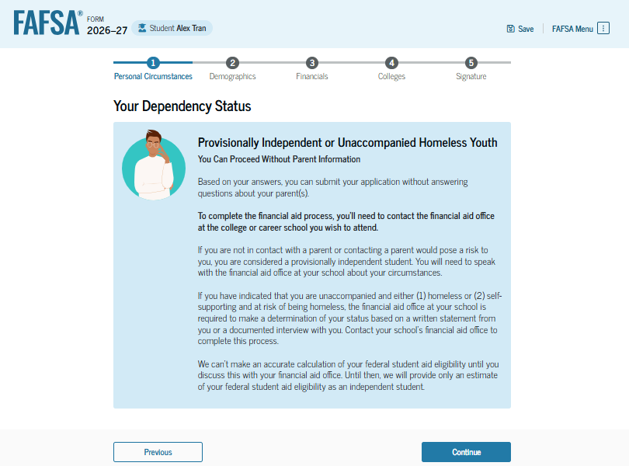
Impact of Unaccompanied Homeless Youth Status
Based on the answers provided by the student, parent information is not required on the FAFSA® form. The student can sign and submit the FAFSA form, but will need to contact the school’s financial aid office about their circumstances. The school will be required to make a determination about the student’s unaccompanied homeless youth status based on a written statement from the student or a documented interview with the student. Until the student’s circumstances are verified, the U.S. Department of Education’s office of Federal Student Aid will only provide the student an estimate of their federal student aid eligibility.

Slide 7
Provisionally Independent Student

Slide 8
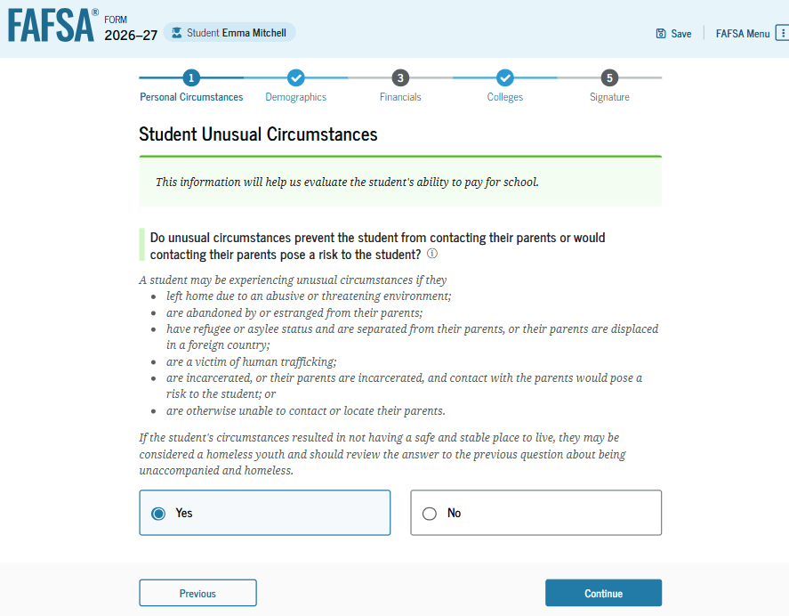
Student Unusual Circumstances
The student is asked if unusual circumstances prevent them from contacting their parent(s). The student selects "Yes."

Slide 9
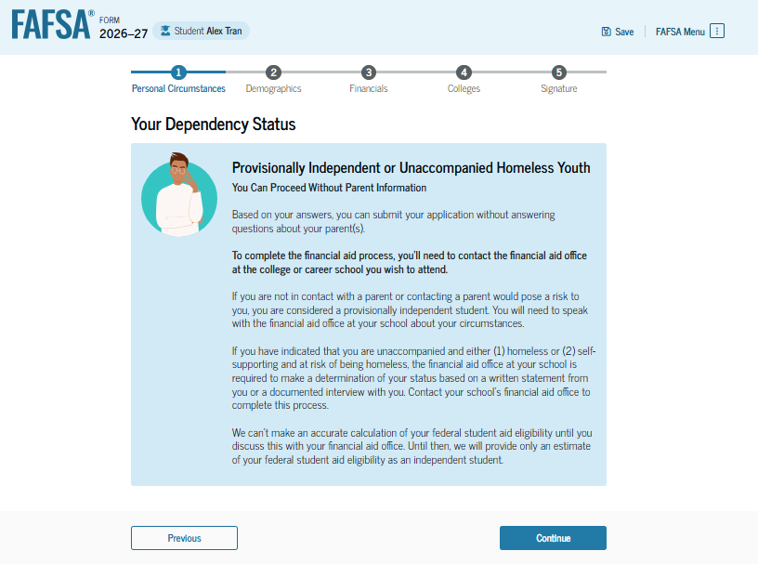
Impact of Provisionally Independent Status
Based on the answer provided by the student, the student is considered a provisionally independent student and is not required to provide parent information. The student can sign and submit their FAFSA® form, but will need to contact their school to see what supporting documentation they need to submit. A financial aid administrator at the school will review and make a determination about a dependency override. Until the student’s circumstances are verified, the U.S. Department of Education’s office of Federal Student Aid will only provide the student an estimate of their federal student aid eligibility.

Slide 10
Student Submits a Required FAFSA® Correction to Homeless Determination

Slide 11
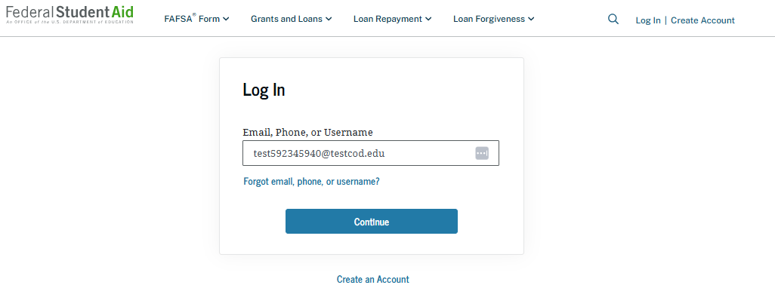
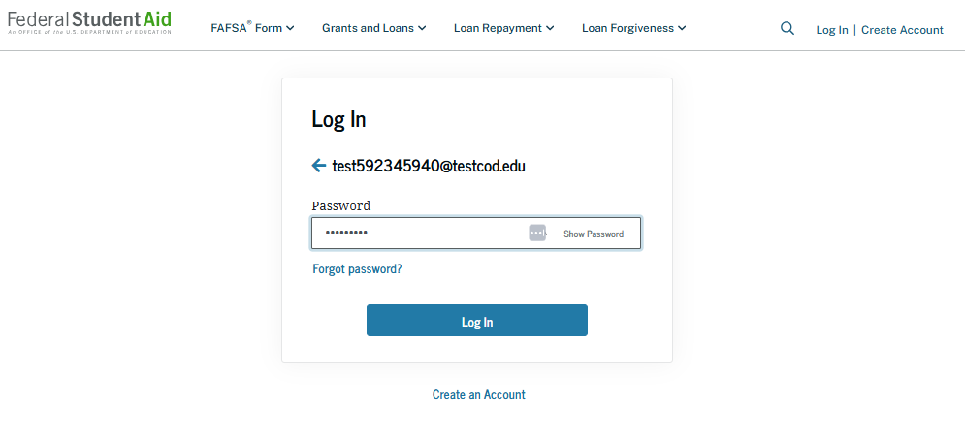
Homeless Determination Correction: Log-in
To access an existing FAFSA® form, the student is required to log in using a StudentAid.gov account username and password.

Slide 12
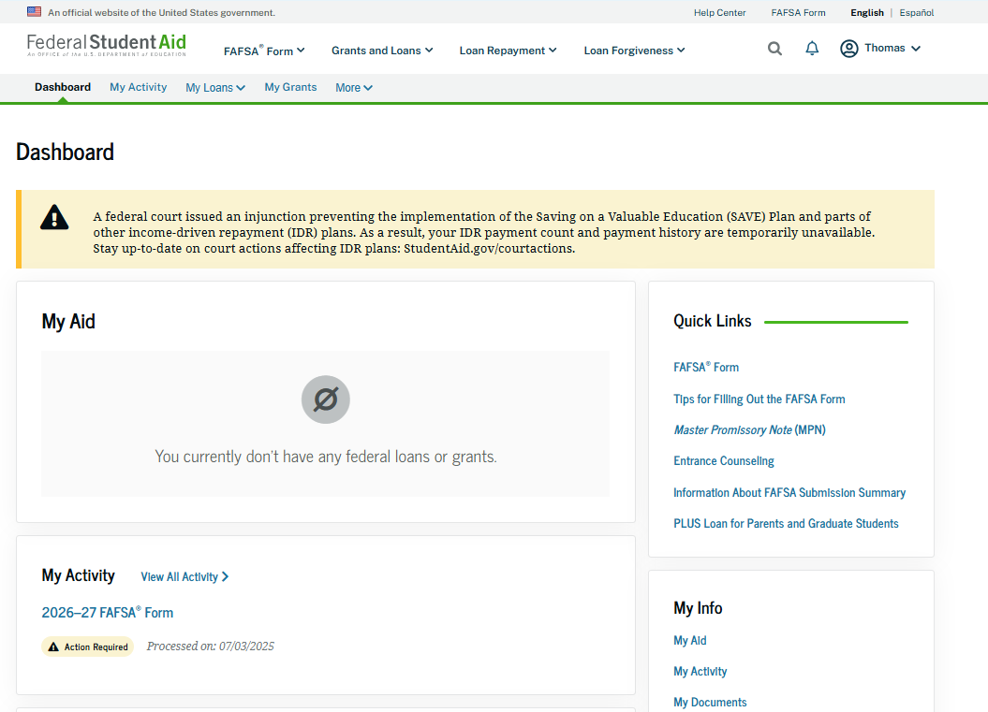
Homeless Determination Correction: Dashboard
On the account Dashboard, the student can see their most recent 2026–27 FAFSA® activity under the "My Activity" section. In this scenario, the student has a 2026–27 FAFSA form that requires additional action before it can be processed. To see further information about this application, the student selects the application and is taken to the "Details" page.

Slide 13
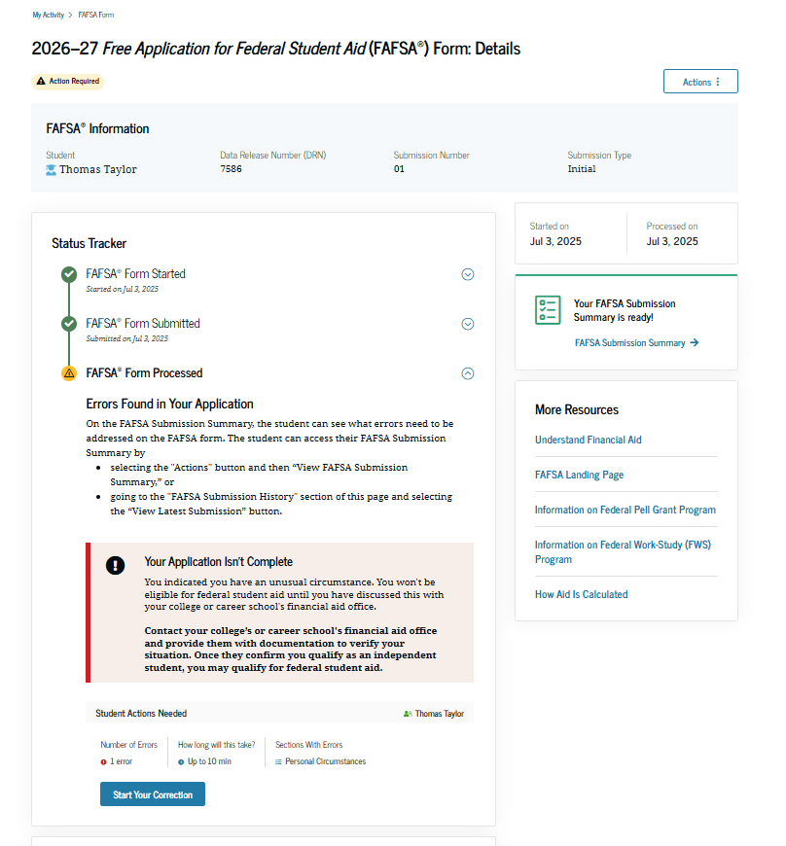
Homeless Determination Correction: Details
On the "Details" page, the student sees information about their FAFSA® form, including that an error was found in their form and that the student must contact their school’s financial aid office to provide documentation of their circumstances. The student can select "Start Your Correction" to start a required correction.

Slide 14
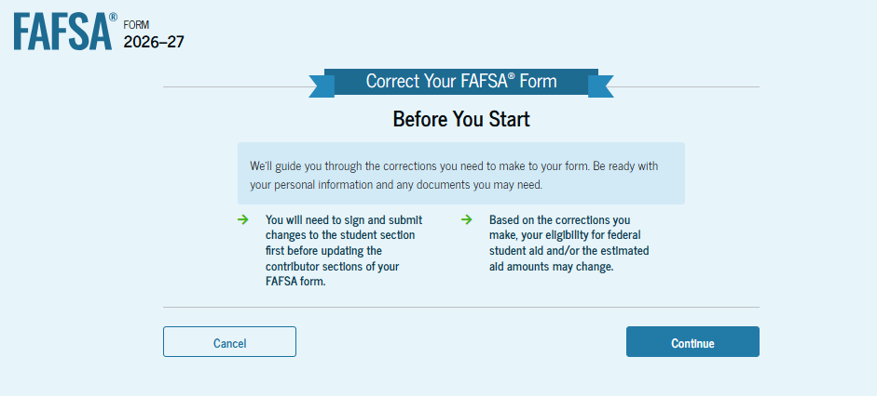
Homeless Determination Correction: Onboarding
When the student starts a 2026–27 FAFSA® correction, they are taken through the FAFSA correction onboarding process. A correction should only be submitted if critical information was missing, the form contains incorrect information, the student needs to update the selected school(s), and/or a financial aid administrator requested a correction.

Slide 15
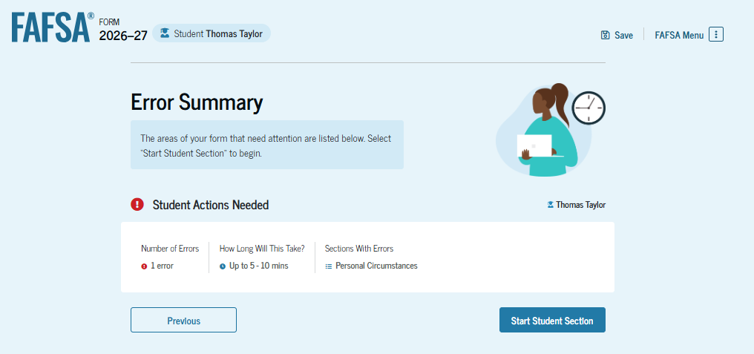
Homeless Determination Correction: Error Summary
When a student is updating an error on the FAFSA® form, they are taken to the
"Error Summary" page. The student can review the number of errors on their form, the estimated time to correct the errors, and the section(s) of the FAFSA form that contain the error(s). The student selects "Start Student Section" to begin the FAFSA correction.

Slide 16
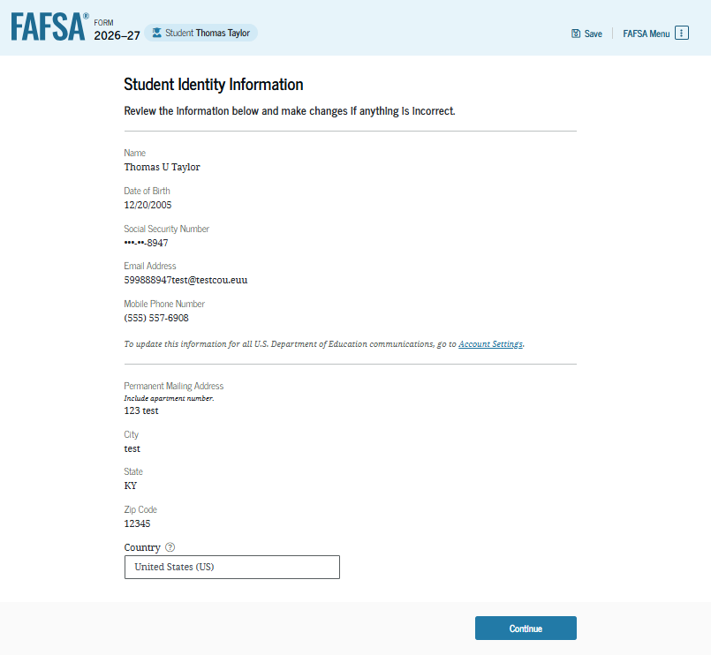
Homeless Determination Correction: Student Identity Information
The "Student Identity Information" page is the first page within the FAFSA® form that requires information from the student. The student does not change the information shown because it is correct; the student selects "Continue."

Slide 17
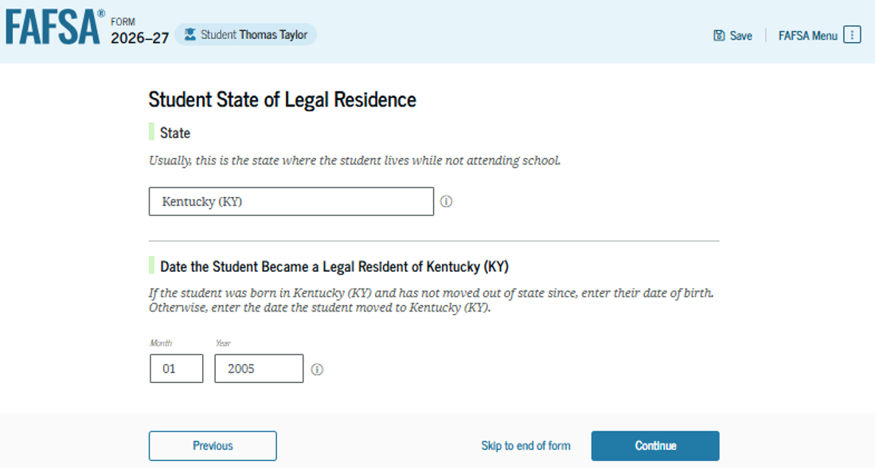
Homeless Determination Correction: State of Legal Residence
The student is asked about state of legal residence. The student does not change the state selected from the drop-down box or the month and year when they became a legal resident. ​

Slide 18
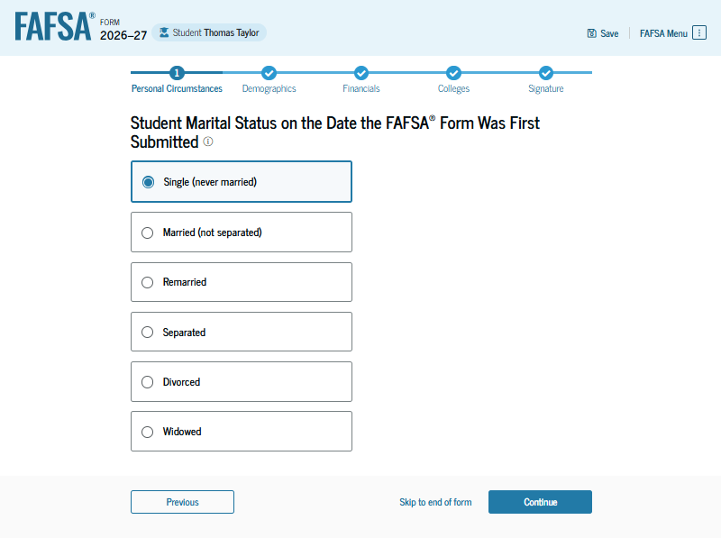
Homeless Determination Correction: Marital Status
The "Student Marital Status" page is the first question within the "Your Personal Circumstances" section. The student is asked about their current marital status. The student does not change their response of "Single (never married)."

Slide 19
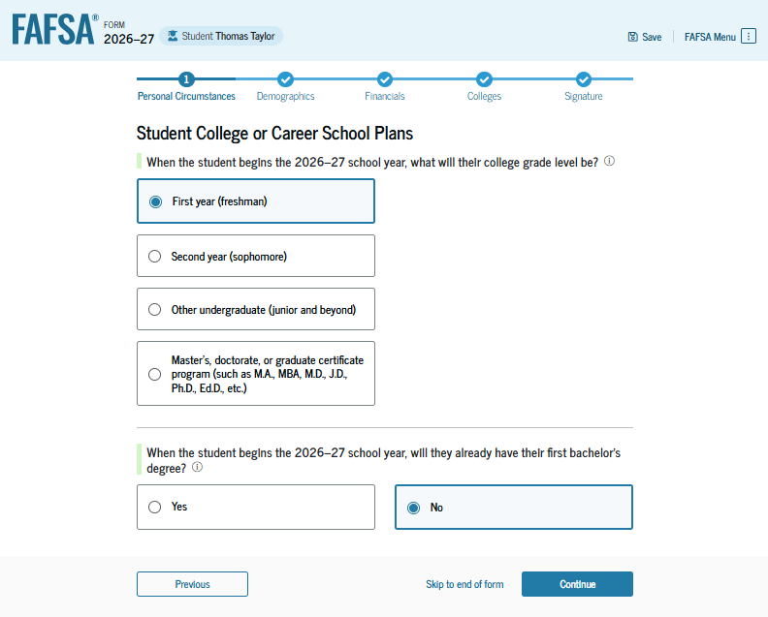
Homeless Determination Correction: College or Career School Plans
The student is asked about their college grade level for the 2026–27 school year and if they will have their first bachelor’s degree. The student does not change their responses of "First year (freshman)" and "No."

Slide 20
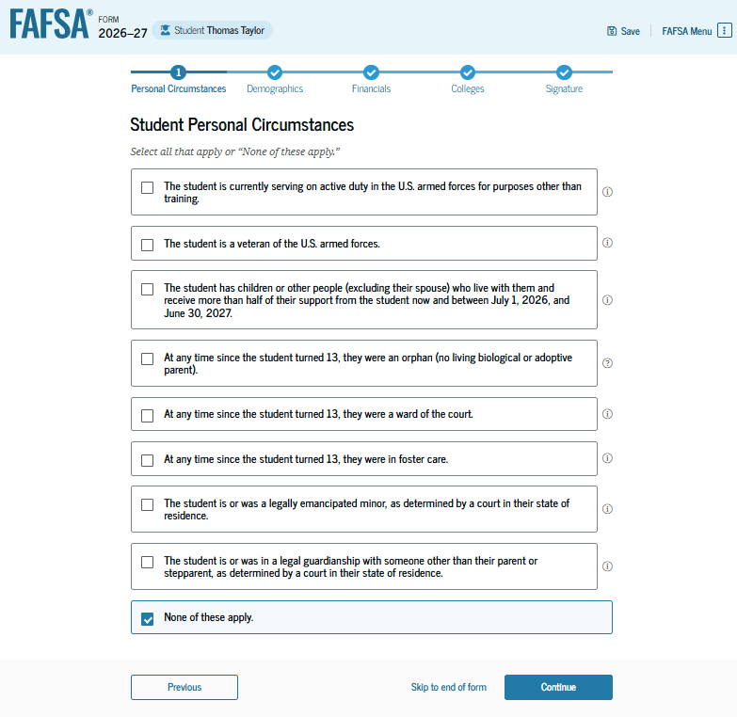
Homeless Determination Correction: Personal Circumstances
The student is asked if any of the listed personal circumstances apply to them. The student does not change their response of "None of these apply."

Slide 21
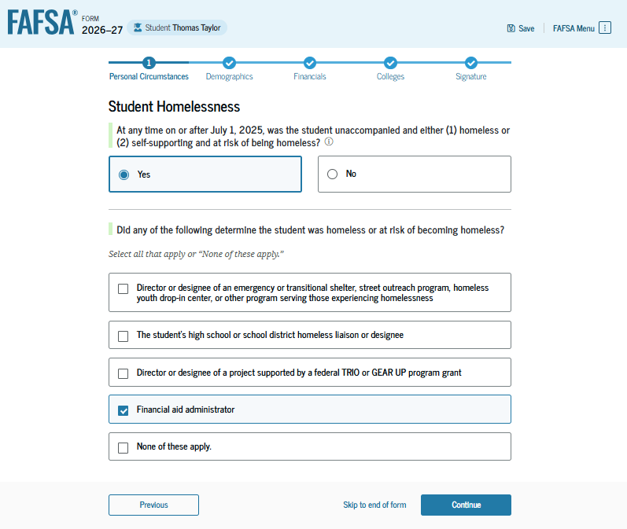
Homeless Determination Correction: Other Circumstances
The student is asked if they were homeless or at risk of being homeless. The student does not change the response of "Yes." After selecting this response, the student is asked who made the homelessness determination. The student updates their answer from "None of these apply" to "Financial aid administrator."

Slide 22
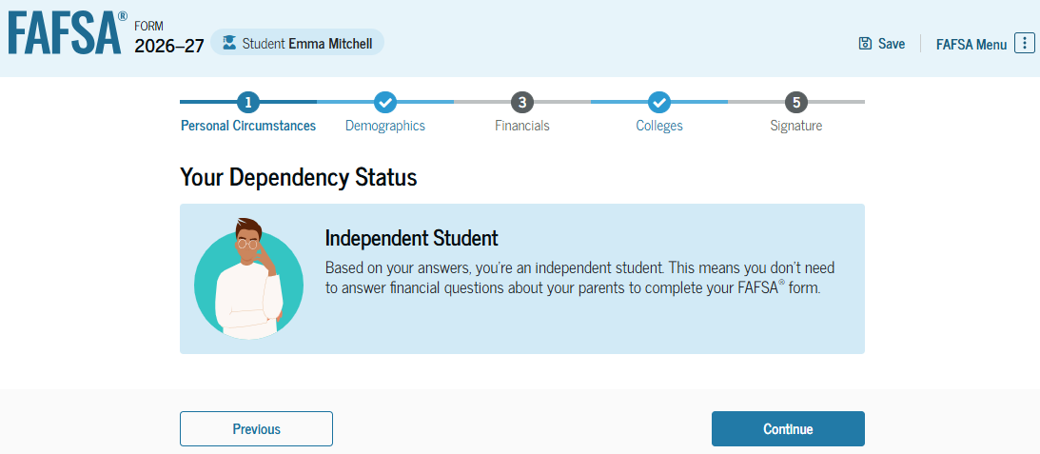
Homeless Determination Correction: Dependency Status
Based on the updated answer provided by the student, the student is considered an independent student. The student selects "Continue" and enters the "Student Demographics" section.

Slide 23
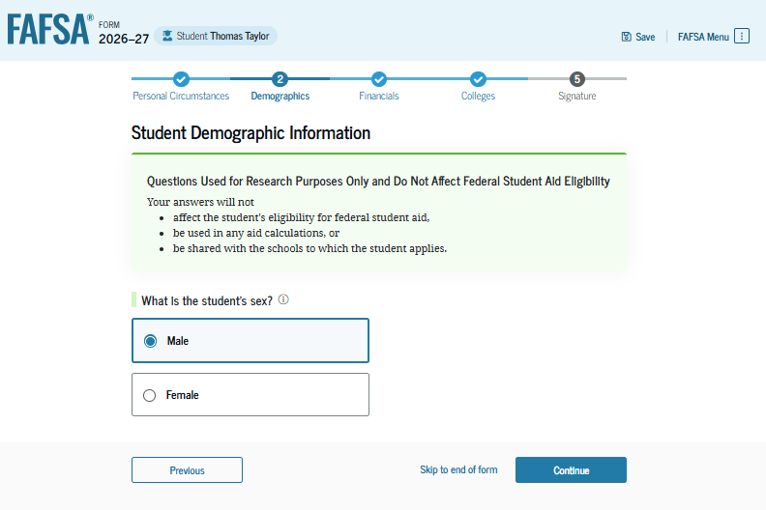
Homeless Determination Correction: Demographic Information
The "Student Demographic Information" page is the first question within the "Student Demographics" section. The student is asked to identify their sex. The student does not change their response of "Male." Since the student has finished the correction, they select "Skip to end of form" to proceed with submitting the correction.​

Slide 24
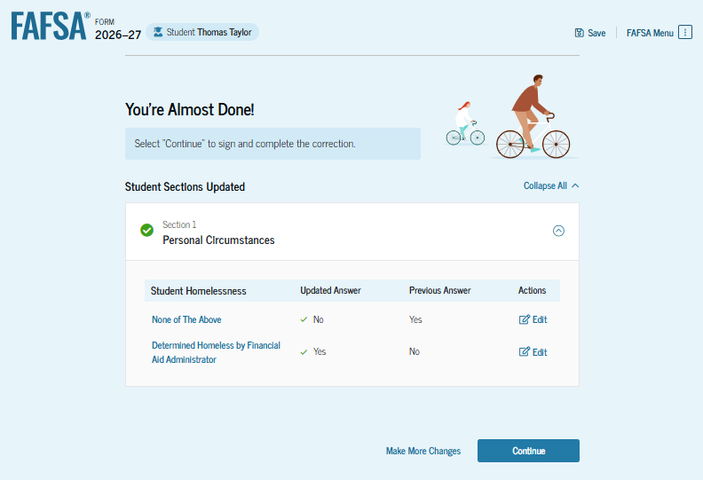
Homeless Determination Correction: Review Changes Page
The review changes page displays the responses that the student has updated in the FAFSA® form. The student can view all their updated and previous answers by selecting "Expand All" or by expanding each section individually. To edit a response, the student can select the "Edit" button beside each question to be taken to the corresponding page. If the student needs to make additional updates, they can select "Make More Changes." The student is ready to submit the correction and selects "Continue."

Slide 25
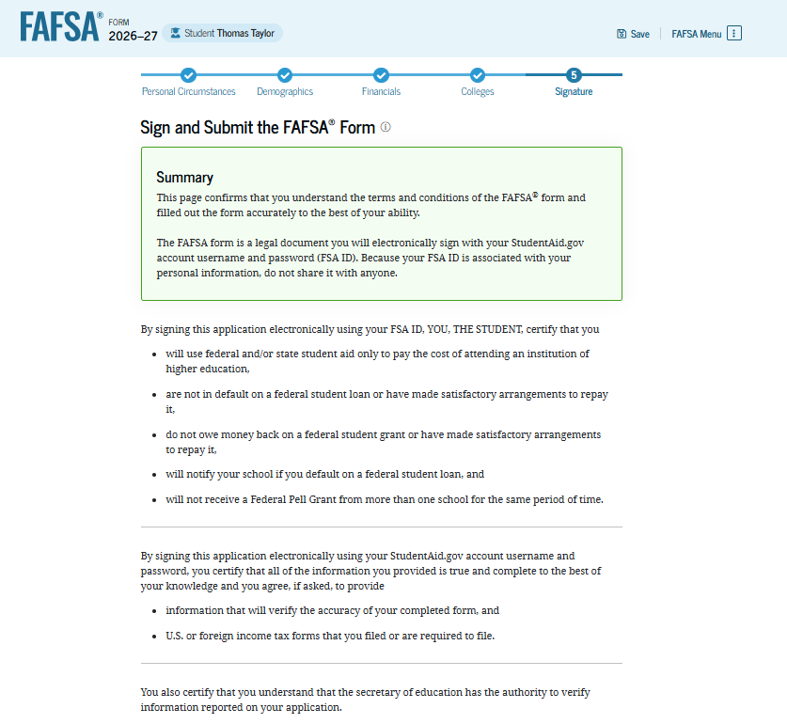
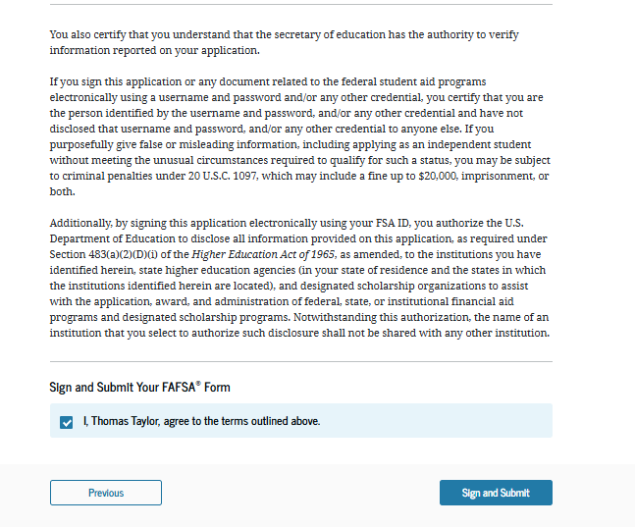
Homeless Determination Correction: Signature
After confirming the changes, the student reviews, digitally signs, and submits the terms and conditions of the FAFSA® form.

Slide 26
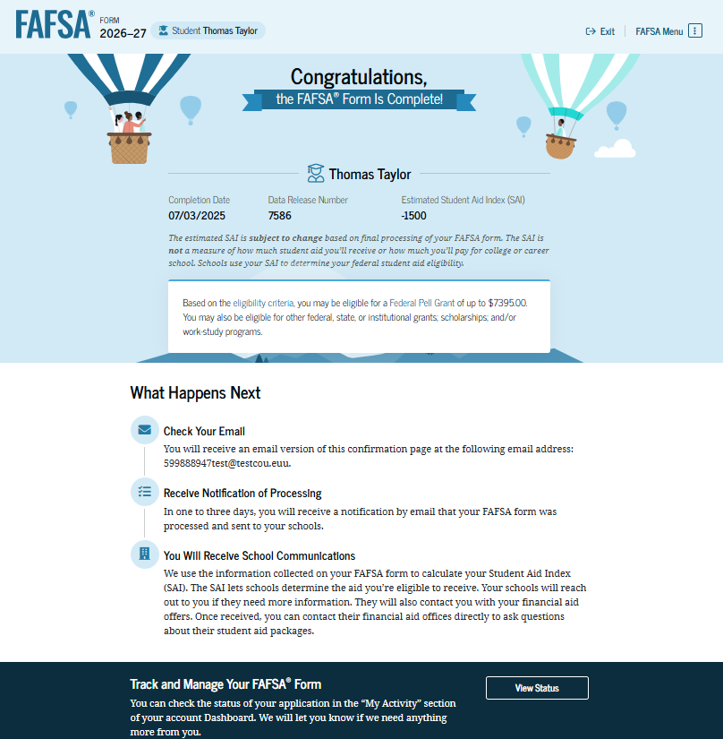
Homeless Determination Correction: Confirmation
After the student has submitted the correction, they are presented with the confirmation page. This page displays information for the student about next steps, including tracking their FAFSA® form and correction.

